Slide 1
MrDresser – Personalized Fashion Recommender
Presented by:
Umair Ahmad
Aqeel Abbas Khan

Slide 2
Agenda
SRS Overview
Detailed Design Document (DDD)
Test Report
Q&A

Slide 3
Functional Requirements (FR)
User Profile & Personalization:
Create/Update user profiles (age, gender, weight, profession).
Upload pictures for automatic face shape/skin tone detection.
Analyze images for face shape and color.
Handle invalid image formats (JPG/PNG only).
Allow profile viewing and editing.
Filter/prioritize outfit recommendations based on profile data/uploaded image.
Admin Dashboard & Management:
Provide a dashboard for user/vendor monitoring.
Approve/Reject vendor listings.
Remove inappropriate/invalid content.
Log admin activities for auditing.

Slide 4
Functional Requirements (FR)
Vendor Profile & Business Management:
Create/Update vendor business profiles.
Upload product listings (name, description, price, images).
Validate input fields and image formats for products.
Securely store vendor data.
Product/Service Search:
Perform keyword-based searches.
Filter results by product category and vendor type.
Sort results by proximity (if location access granted).
Gracefully handle empty search results.

Slide 5
Non-Functional Requirements (NFR)
Performance
Page must load in less than 3 seconds.
Search results must return in less than 2 seconds.
System should support 100+ concurrent users without performance degradation.
Safety:
Implement a regular database backup strategy (daily incremental + weekly full).
Error logs must be maintained with alert notifications for critical failures.
Security:
Passwords stored using hashing .
All communications via HTTPS.
Strong authentication for admin access.
Secure HTTP(S) with token/OAuth for all user roles.
Secure transmission and storage of sensitive user data.

Slide 6
Constraints and Other Parameters
Time Duration:
The project must be completed within 5 to 6 months.
Budget Constraint:
Total project budget is 7 to 8 lacs.
Technology Stack Preference:
The client prefers open-source technologies to minimize licensing costs

Slide 7
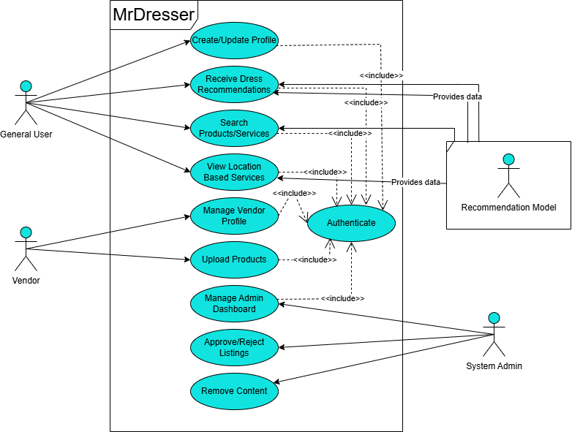
Use Case Diagram:

Slide 8
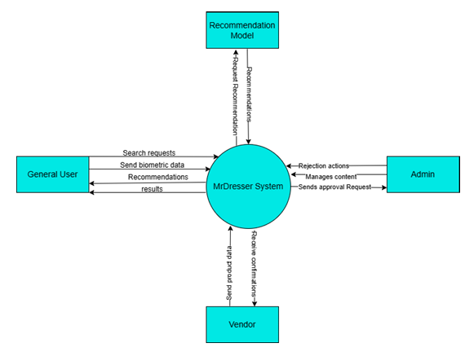
Level 0 DFD:

Slide 9
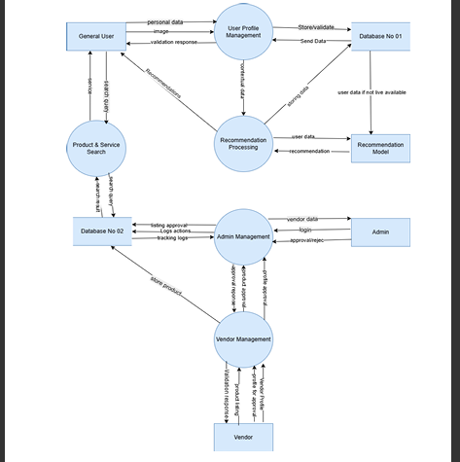
DFD Level 01

Slide 10
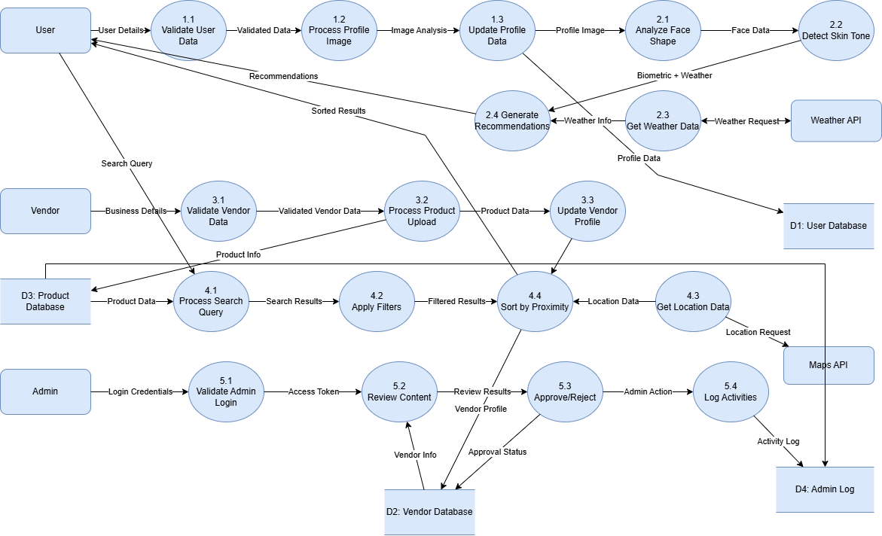
DFD Level 02:

Slide 11
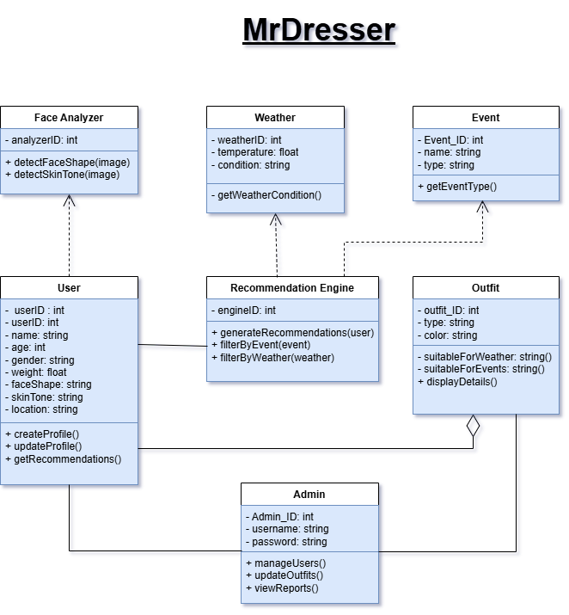
Class Diagram:

Slide 12
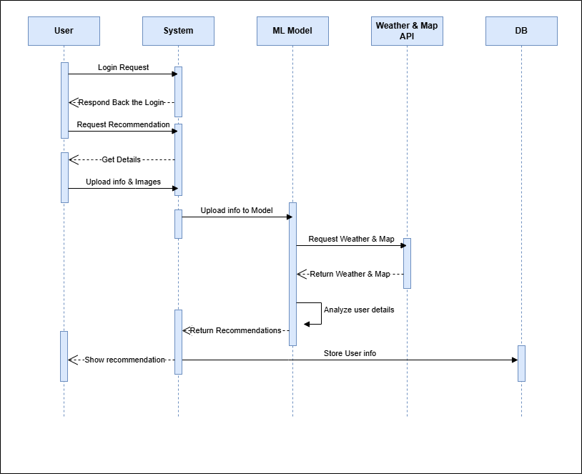
System sequence Diagram: User

Slide 13
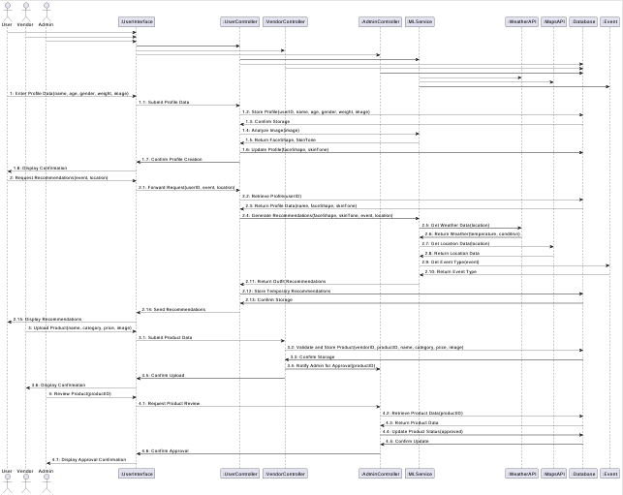
System sequence Diagram:

Slide 14
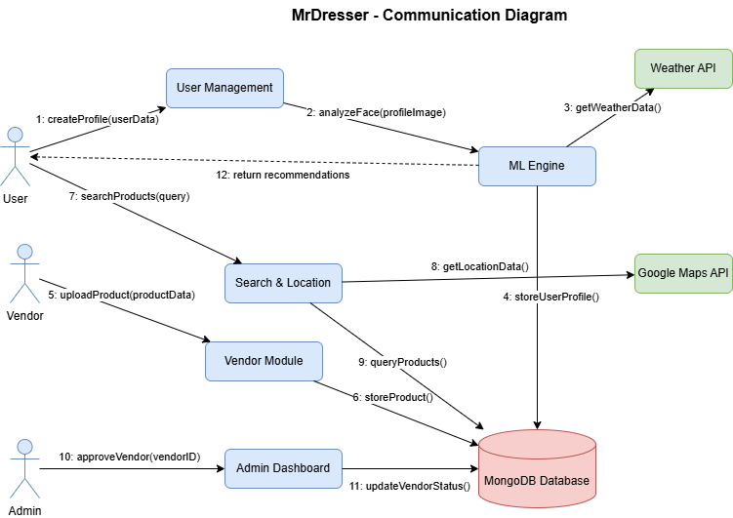
Communication Diagram:

Slide 15
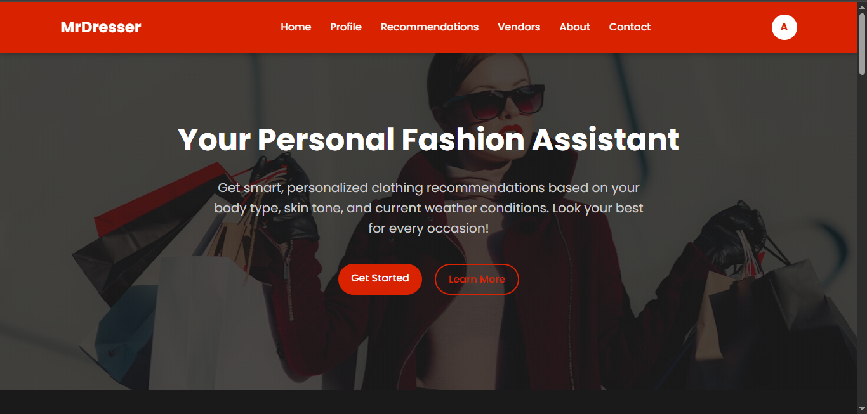
Home Page

Slide 16
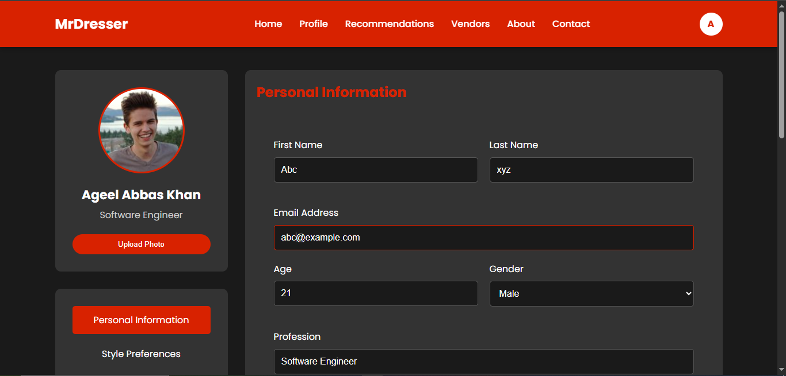

Slide 17
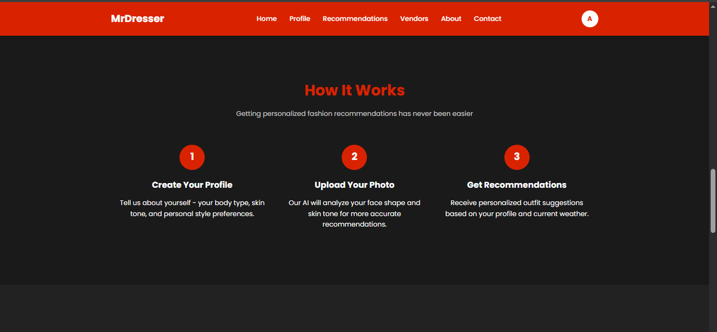

Slide 18
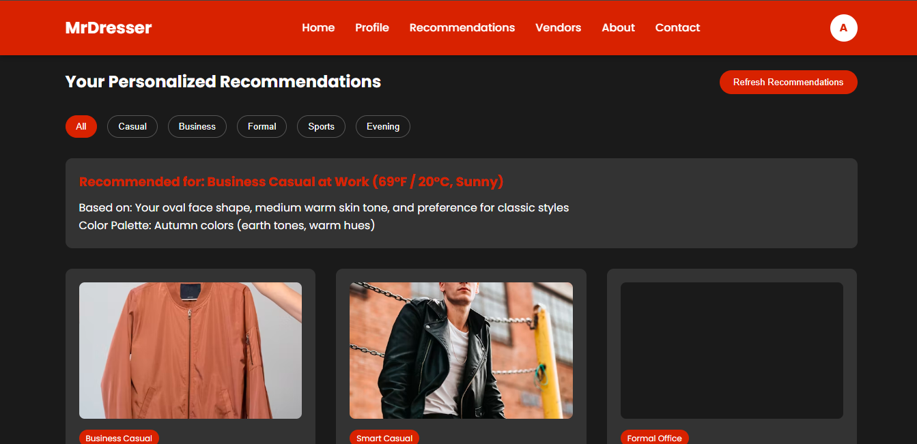

Slide 19
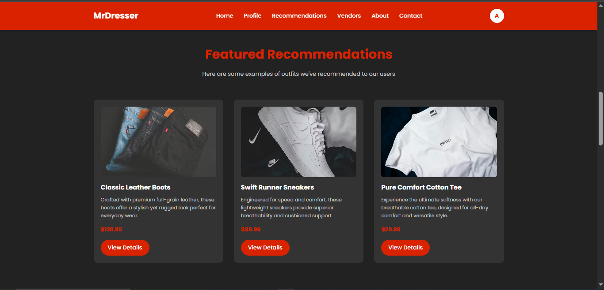


Slide 20
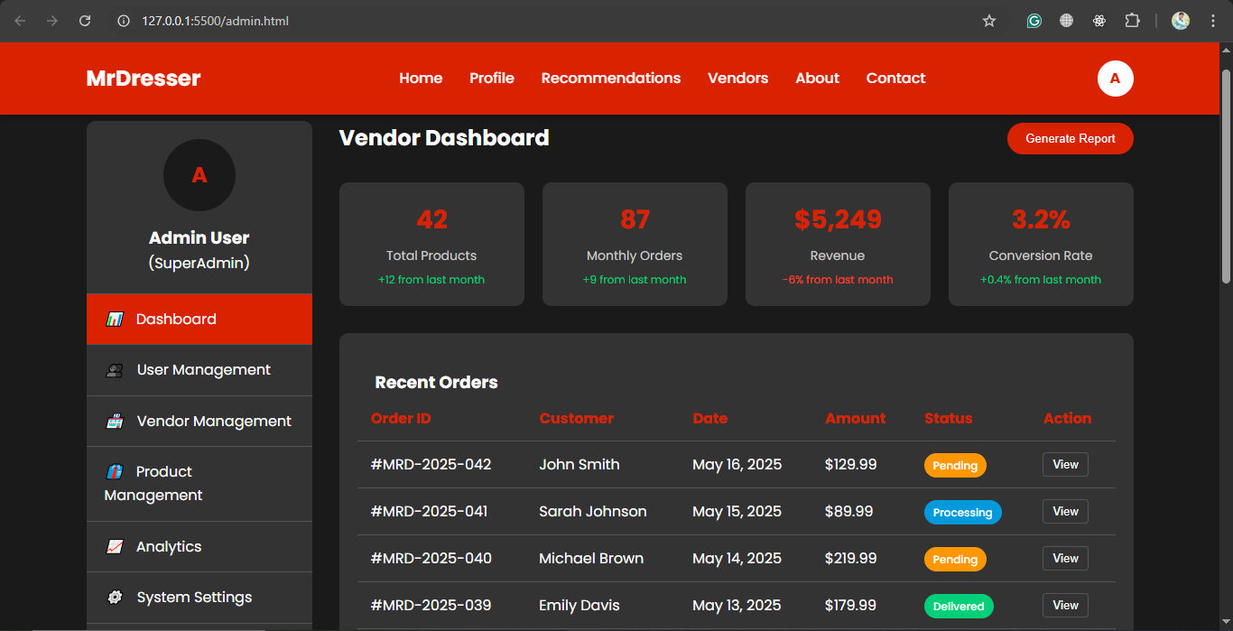

Slide 21
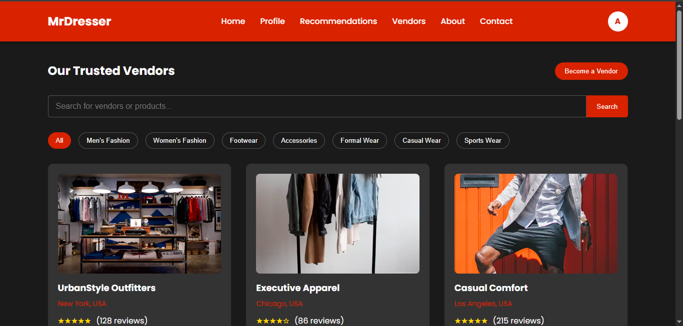

Slide 22

Test Types
Functional Testing
UI and Workflow Validation
Black-box Testing
Module-wise Feature Verification

Slide 23
Test Cases
User Profile Interface
TC_UI_01: Create/Update Profile – PASS
TC_UI_02: Upload Image for ML Analysis – PASS
Recommendation Interface
TC_REC_01: Generate Outfit Recommendations – PASS
TC_REC_02: Update Recommendations – PASS
Vendor Dashboard
TC_VD_01: Upload Product – PASS
TC_VD_02: View Product Listing – PASS
Admin Panel
TC_ADM_01: Approve Product – Fail
TC_ADM_02: Reject/Delete Product – PASS

Slide 24
Module | Test Cases | Passed | Failed | Remarks
User Profile | 2 | 2 | 0 | All functional
Recommendation | 2 | 0 | 2 | ML Triggered
Vendor Dashboard | 2 | 2 | 0 | UI validated
Admin Panel | 2 | 1 | 1 | Logs maintained
Total | 8 | 5 | 3 | 62.5 % Pass Rate
Test Report & Status

Slide 25
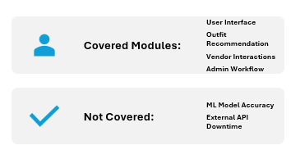
Test Coverage

